Slide 1
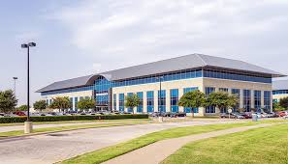
NEC Reentry to Workplace (Irving)
3929 W. John Carpenter Frwy.

Slide 2
Strategies
Communication/ Training
Fun Video “what you’ll find when you return”
Signs everywhere
Employees want to engage
Weekly call with all managers (nationally)
Food Drive for employee engagement
Tiptoe into the water
Try to avoid start-stop- 3 Phases – 12% Phase I
Cleaning Protocols
Fumigation
Deep Cleaning
Self-help in the workspace
Social Distancing
Office Layout
Common Areas
Elevators/ Restrooms/ Lunchrooms/ Dining/ Conf. Rooms
Code of Conduct/ Policy for Reentry into Workplace

Slide 3
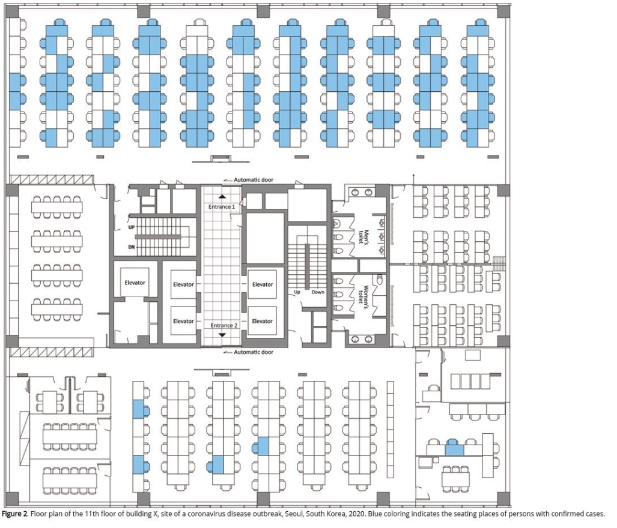
South Korea – Office Contamination
Floor contained 216 employees; 1 employee infected 94 of which 2 never showed symptoms. 216:1:94
Workplaces: Another great example is the outbreak in a call center (see below). A single infected employee came to work on the 11th floor of a building. That floor had 216 employees. Over the period of a week, 94 of those people became infected (43.5%: the blue chairs). 92 of those 94 people became sick (only 2 remained asymptomatic). Notice how one side of the office is primarily infected, while there are very few people infected on the other side. While exact number of people infected by respiratory droplets / respiratory exposure versus fomite transmission (door handles, shared water coolers, elevator buttons etc.) is unknown. It serves to highlight that being in an enclosed space, sharing the same air for a prolonged period increases your chances of exposure and infection. Another 3 people on other floors of the building were infected, but the authors were not able to trace the infection to the primary cluster on the 11th floor. Interestingly, even though there were considerable interaction between workers on different floors of the building in elevators and the lobby, the outbreak was mostly limited to a single floor (ref). This highlights the importance of exposure and time in the spreading of SARS-CoV2.
EDITOR'S NOTE: Erin S. Bromage, Ph.D., is an Associate Professor of Biology at the University of Massachusetts Dartmouth.

Slide 4
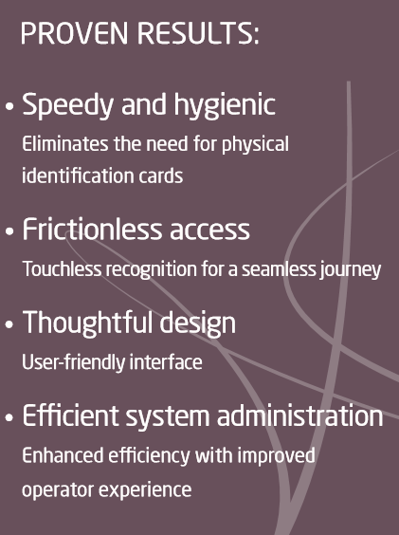

Slide 5
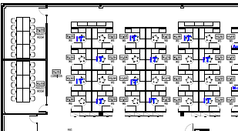
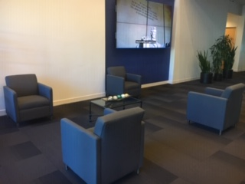
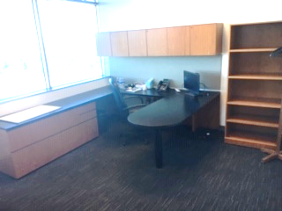
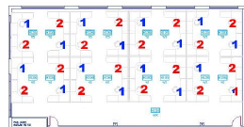
Offices and Cubicle Areas
Workspace
x
x
Common Areas
Office
Call Center

