Slide 1
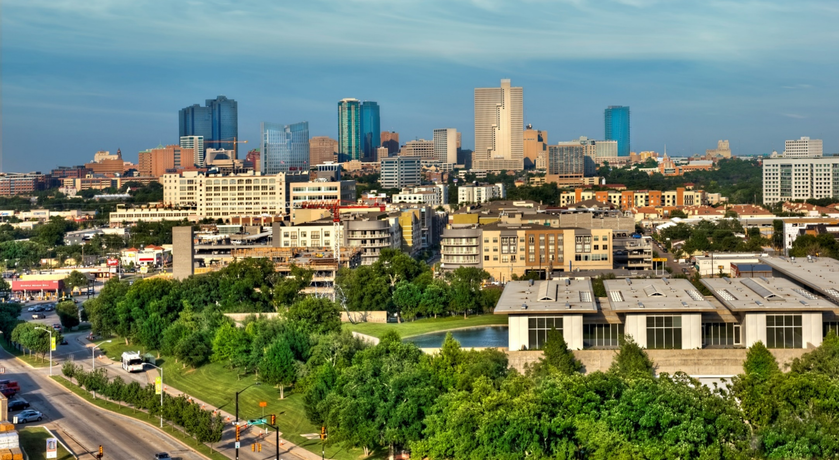
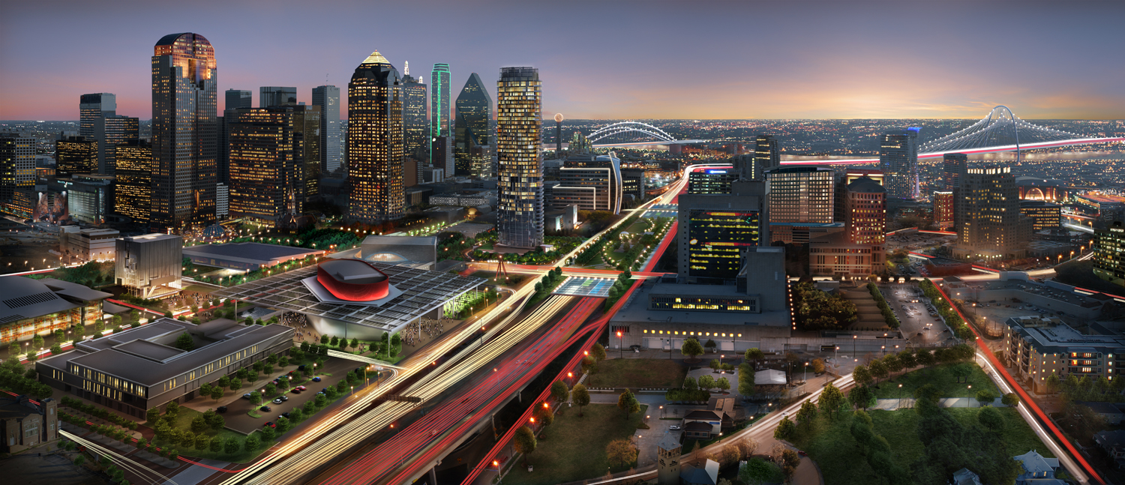
ダラス・フォートワース 日本企業 歓迎
Notes:
Good evening.
It’s a pleasure to spend some time this evening telling you a little more about our region. Sarah and I will be available for a Q&A following the end of this presentation, and look forward to your questions!
Let’s get started.

Slide 2
ストックホルム
ロンドン
モスクワ
ベルリン
オタワ
パリ
ワシントンD.C.
北京
DFW
東京
メキシコシティ
リオデジャネイロ
シドニー
Notes:
This maps shows were DFW is in relation to the rest of the world.

Slide 3
シアトル
ポートランド
ボストン
デトロイト
シカゴ
ニューヨーク
フィラデルフィア
サンフランシスコ
デンバー
インディアナポリス
ワシントンDC
ラスベガス
ロサンゼルス
アルバカーキ
シャーロット
フェニックス
アトランタ
DFW
オースティン
ヒューストン
サンアントニオ
マイアミ
Notes:
Texas is the 2nd biggest state by geographical region after Alaska.
This map shows where Texas is in relation to the rest of the United States, and where Dallas-Fort Worth is in relation to the state.
We are bordered by New Mexico, Oklahoma, Arkansas, and Louisiana. Texas share its southern border with Mexico.

Slide 4
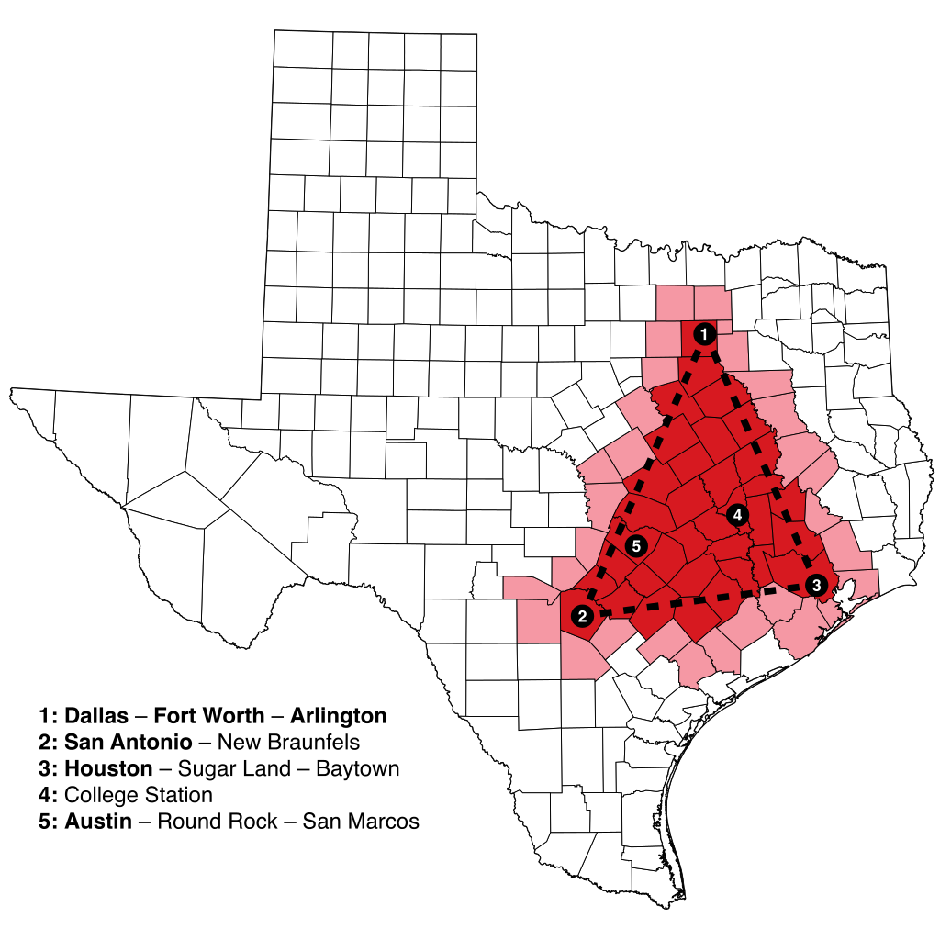
テキサストライアングル
Notes:
DFW sits at the northern end of what is called the TX Triangle, which includes the Austin and San Antonio metros to the southwest, and the Houston metro to the southeast.
Although Texas is a very large state, this area of concentration for Texas’ population and economy is much smaller, making the Texas market surprisingly accessible for a company locating in or near the triangle.
In fact, ~75% of Texas’ population and economic activity is located within or near the TX Triangle.
For your reference, it is about 250 miles (~400km) from DFW to Houston. The DFW-Houston corridor connects 2 of the 5 largest U.S. metropolitan areas.
The DFW-Houston corridor will be the first in the country to have a high-speed bullet train, projected for completion in the next 5 or 6 years.
DFW and Houston each represent about 1 in 4 residents, together accounting for half of Texas’ population.

Slide 5
最大のテキサスメトロポリタン地区
26%
24%
テキサス州の人口 2900万人
DFWとヒューストンは、それぞれ テキサス州の住人の約1/4を抱えており、テキサス州の人口の半分がこの 2都市に居住しています。
9%
8%
DFW
ヒューストン
サンアントニオ
オースティン
740万人
690万人
250万人
230万人
Notes:
I want to start the bulk of my presentation by talking about the people who make up the region, since we are arguably our region’s most valuable assets.
Texas has the 2nd highest population of any U.S. state, second only to California according to a 2016 U.S. Census population estimate.
As I mentioned before, DFW and Houston combined make up just over half of the state’s total population.

Slide 6
米国地域人口ランキング 1990年
1. ニューヨーク
1680万人
2. ロスアンゼルス
1130万人
3. シカゴ
820万人
4. フィラデルフィア
540万人
5. デトロイト
420万人
6. ボストン
410万人
7. ワシントンD.C.
410万人
8. マイアミ
410万人
9. ダラス・フォートワース
390万人
10. ヒューストン
380万人
Notes:
We weren’t always the population powerhouse that we are today.
Just 24 years ago, Dallas Fort Worth was the 9th largest U.S. metro area.

Slide 7
米国地域人口ランキング 2017年
1. ニューヨーク
2020万人
2. ロスアンゼルス
1340万人
3. シカゴ
950万人
4. ダラス・フォートワース
740万人
毎年住人が140,000人増加
5. ヒューストン
690万人
6. ワシントン D.C.
620万人
7. フィラデルフィア
620万人
8. マイアミ
610万人
9. アトランタ
590万人
10. ボストン
480万人
Notes:
Now, DFW is the 4th largest U.S. metro area.
DFW adds more than 140,000 new residents annually. That’s like adding another Dayton, OH, Fullerton, CA, or Bellevue, WA to the region every year!
Although Houston proper has a larger population than Dallas proper, the various suburbs and cities in this region push our total to exceed Houston’s regional population by about 400,000 people.

Slide 8
DFW 人口 増加推定
3.3分
1時間
1日
1週間
1年
1人
18人
432人
3,024人
140,000人
7,894,214
10,001,371
12,890,587
16,768,007
2020
2030
2040
2050
Notes:
43% of residents are added through net natural increase – or birth rate over death rate
57% of residents are added through net migration from other regions
67% net domestic migration
33% net international migration
If population growth trends across the country remain the same and we continue to add a new resident every 3 minutes or another 430 people a day, we will have a population of just over 10M by 2030, overtaking Chicago to become the 3rd largest metropolitan region in the U.S.

Slide 9
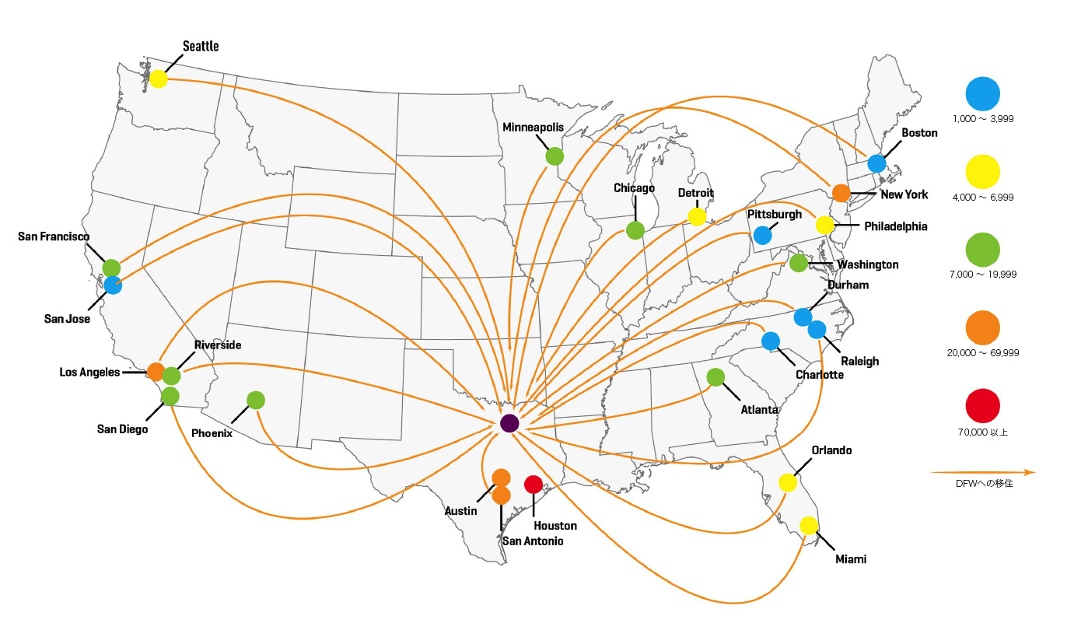
移住 パターン
Notes:
Here you can see where this region’s domestic in-migrants are coming from.
We gain population most heavily from larger, more expensive markets, like New York, California, and Illinois. In the last 5 years, we have seen net positive migration from all major U.S. regions.
~20% of that inbound population is 18-34 year-olds, with bachelor’s degrees or higher, working in professional occupations.

Slide 10
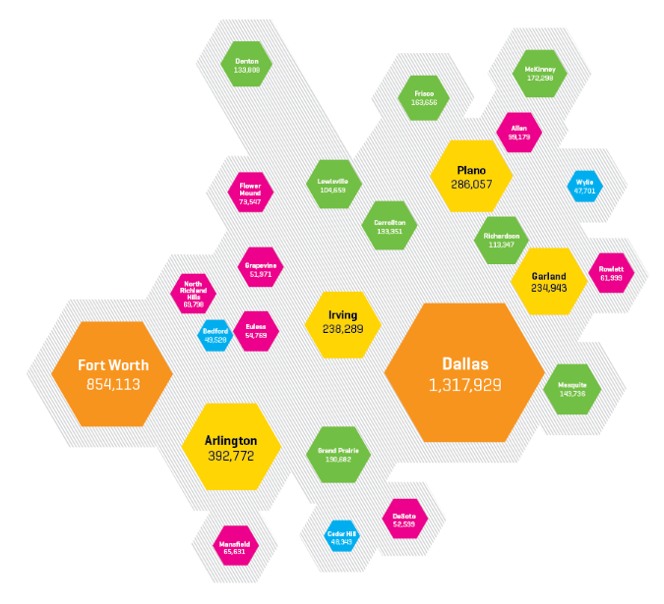
人口分布
Notes:
From 2010-2015, DFW experienced an average annual population increase of ~10%, second only to Houston’s growth of 11% each year.
This hex map reflects how that DFW population is distributed across the metroplex, with the cities of Dallas and Fort Worth anchoring the region.
Speaking to the scale of North Texas, there are 14 cities in this region with 100,000+ people. If you take out the two anchor cities, 5.2M people live in the surrounding cities and suburbs.
Each city is unique in its offerings, with housing options in urban or suburban environments, and with great access to light rail stations, airports, or toll roads to help residents get where they need to go for work and play.

Slide 11
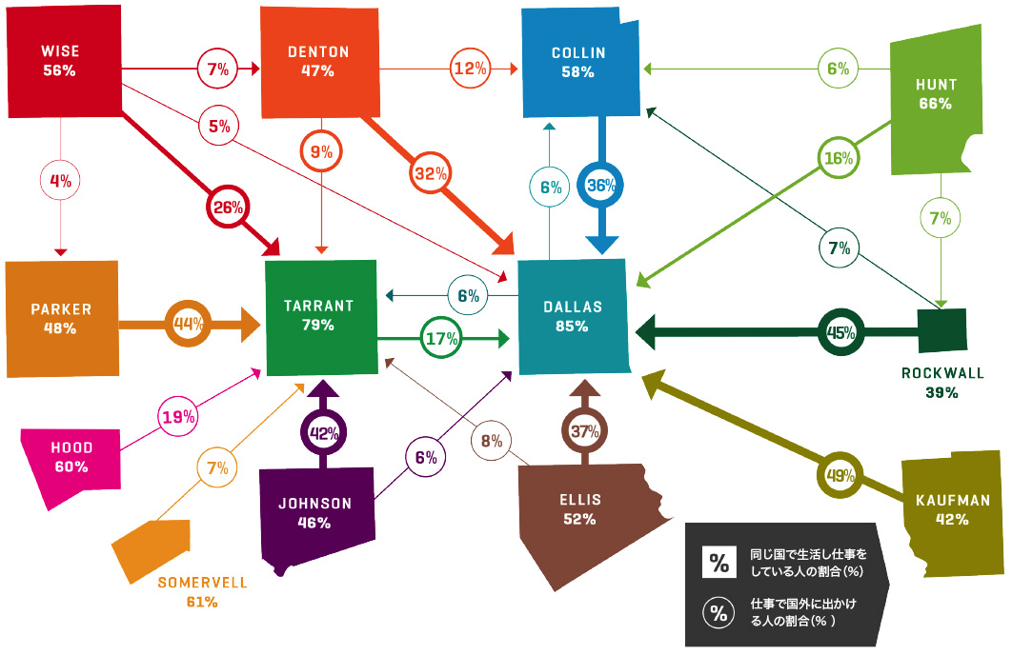
通勤 パターン
Notes:
Something that makes DFW a great place to live is that regional accessibility.
This map shows the % of people who live and work in the same county. Squares represent those who live and work in the same county, while circles represent outbound commuters to other counties. For example, 85% of Dallas County residents live and work in Dallas County, while 6% commute up to Collin County, where 58% of people don’t commute out for work and 36% commute down to Dallas.
The high percentages inside the county squares here demonstrate how easy and affordable it is to live close to work.
According to the TomTom Traffic Index, DFW is the least congested of all major global regions with 5M+ people. DFW congestion has remained consistent despite population growth, reflecting the $2B year-over-year investment made in transit improvement projects.
The ability to live and work in the same county allows employers to capture more of the labor market in their immediate area, while the ease of access to other parts of the region allows individuals to commute if they find a city that matches their personal expectations for cost and quality of living.

Slide 12
DFWの経済
生活費
ビジネスコスト
100
米国平均
ベッド4台およびトイレ2つがある住居が、 サンフランシスコでは$100万であるのに対して、 ダラスではわずか$27万5000です。
ダラスで事業を行う場合の費用は全国平均と比べて3%低くなります。
Notes:
Regional accessibility is just one of the ways in which DFW offers a high quality of life to its residents.
We can tell by looking at these graphs that Dallas is very competitive when you consider both the average cost of living and the average cost of doing business.
As shown here, you can purchase a 4 bedroom house for just under $300,000 in Dallas, compared to a similarly-sized house in San Francisco for over $1M. Housing alone in DFW costs 4-12% less than the national average, and costs more than 50% less than housing in many other major metropolitan areas – not to mention the lower cost of utilities, groceries, and services. In short, you can get a lot more for a lot less.
You can also operate a business efficiently. The cost of doing business – from a tax, insurance, and regulatory standpoint – is about 7% lower here than the national average. Texas, and DFW especially, is “open for business.”

Slide 13
DFWの経済
労働力
380万人
DFW地域の労働力
4月の雇用増加 （対前年比）
米国主要都市ベスト3
ダラス・フォートワース 119,900 ニューヨーク 113,500 ロスアンゼルス 94,100
Notes:
The region’s accessibility and low cost of living means employers can tap into a strong workforce no matter where in the region they base their operations. 73% of the region’s 7.2M residents are working age, giving companies of all industries a large talent pool to hire from.
DFW consistently ranks as a top 5 U.S. metropolitan area by both actual job growth each year and percentage growth.
In 2015, we had the 3rd largest number of jobs added to the region. DFW companies create, on average, over 100,000 jobs each year; since 2010, they have created over 682,000 jobs.

Slide 14
386,703
テキサス州高等教育を受ける学生数
47,141
2016年における、DFW地区の大学での学士、修士、博士号取得者数
283,846
2016年における、テキサスおよび隣接する4州の100以上の大学からの卒業生数
Notes:
Somebody has to fill all these new jobs!
In 2016, economist Richard Florida, in conjunction with CityLab, released a study on the retention rates of college students by metros. Dallas-Fort Worth ranks 6th of the nation’s metros for retaining 2-year college graduates, and 8th of the nation’s metros for retaining 4-year college graduates.
Dallas-area employers are able to recruit easily from the 100+ universities within Texas and adjacent states, offering a highly educated pipeline of talent.
Few major U.S. markets have deeper student pipelines. This talent pipeline, coupled with Texas’ fast growth dynamic increases the potential for employers to capture these students as future workers.
To help companies recruit new talent, the Dallas Regional Chamber recently launched its Say Yes to Dallas campaign, a marketing campaign designed to show millennials why Dallas is the best place to be for work, family, and fun. SYTD also offers a recruitment toolkit to chamber members, helping them attract potential employees to the area.

Slide 15
テキサスと におけるビジネス環境
Notes:
We’ve talked about the people and we’ve touched on the companies they work for, but I want to dig a little deeper into what makes our business climate so attractive to companies considering where in the U.S. to go for relocation or expansion.
DFW benefits economically from the excellent position of Texas compared to other states.
The next few slides will highlight the reasons why we have such a positive business climate, as compared to other U.S. states.

Slide 16
テキサスと ビジネス環境
仕事に最適な州
Notes:
If you look at a map of the United States and subtract all the states that are not “right to work” states, these are the ones that remain. A right to work state is one in which employees are not required to join unions.

Slide 17
テキサスと ビジネス環境
仕事に最適な州
労働者災害補償が低費用
Notes:
Now we narrow it down to states with low workers compensation insurance costs, meaning it’s less expensive to insure employees against workplace injuries. The average cost to insure an employee in Texas is about $0.75 per $100 in employee wages. For context, the most expensive state average is Alaska, at about $2.75 per $100.
The state of Texas is also unique in that it does not require businesses to purchase coverage except under special circumstances, such as for government-funded projects.

Slide 18
テキサスと ビジネス環境
仕事に最適な州
労働者災害補償が低費用
州所得税を支払う必要がない
Notes:
To narrow it down even further, let’s get rid of states with state income taxes. Texas has no personal or corporate income tax, so you and your employees keep more of each paycheck.

Slide 19
テキサスと ビジネス環境
仕事に最適な州
労働者災害補償が低費用
州所得税を支払う必要がない
CEOが選ぶ、事業に適した州ベスト10にランク入り
Notes:
Of those remaining states, only three - Florida, Nevada and Texas - are considered by U.S. CEOs to be among the top 10 states in the U.S. for operating a corporation, according to a survey performed by CEO Magazine.

Slide 20
テキサスと ビジネス環境
仕事に最適な州
労働者災害補償が低費用
州所得税を支払う必要がない
CEOが選ぶ、事業に適した州ベスト10にランク入り
アメリカの中央に位置し、1日でアクセスできる
Notes:
Finally, of the three remaining states, Texas is the only one that also provides the benefit of a central U.S. location and outstanding access to the U.S. market, from coast-to-coast.

Slide 21
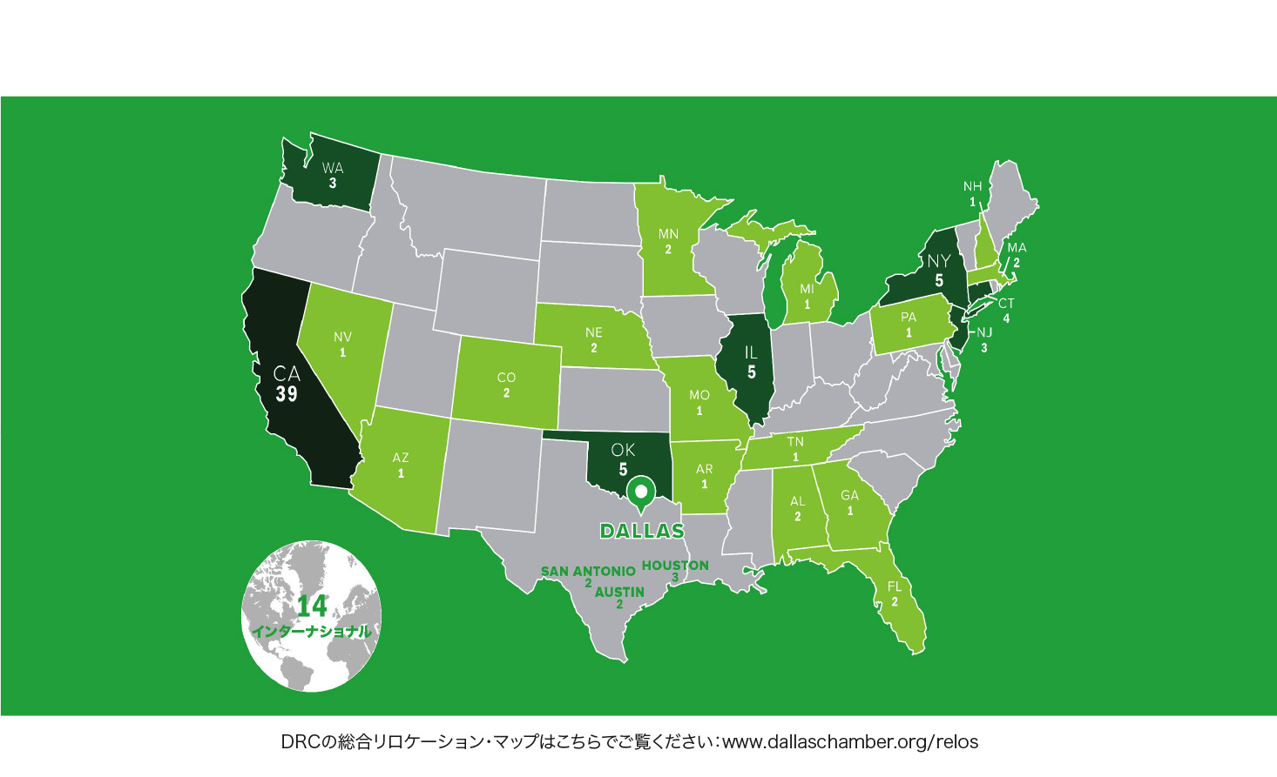
2010年以来118の本社がDFWへ移転
本社移転
Notes:
These factors contribute heavily to the migration of companies and people to the region.
People go where the jobs are, and the business climate, operating advantages, and successes of the DFW area continue to attract U.S. and global companies, especially those that wish to take advantage of our central location and outstanding air service. There have been approximately 106 corporate headquarters moves since 2010, and that’s not even counting the establishment of major distribution, customer support, and manufacturing centers.
Toyota is a major example one such company that chose to relocate. In 2014, Toyota decided to consolidate its U.S. operations in DFW, making the move from California. It was anticipated that maybe 40% of their 4,000 California-, Kentucky-, and NY-based employees would make the move, on par with the national average rate of employees who choose to follow their employers after a move.
Today, we know that just over 70% of Toyota’s employees have opted to relocate to DFW.
Many international companies have established HQs or other facilities in DFW over the last ten years. Some examples include:
Hisun Motors – a Chinese manufacturer of all-terrain vehicles – who opened a new manufacturing plant,
Louis Vuitton – a French luxury leather brand – who just announced a new production workshop,
NTT Data – a Japanese IT company – who just moved their North American headquarters to Plano, and
Zinwave – a British tech firm – who recently moved their NA headquarters to Uptown Dallas.

Slide 22
DFWの経済
産業の多様性
Notes:
As shown on the previous map, companies moving to the region represent a variety of industries. As a result, the DFW region has a very balanced economy, relying on multiple sectors, rather than just one or two. In that sense, it’s like a smaller version of the U.S. economy.
This diversity of industries allows us to flex with the times. If one industry declines, the others balance it out, allowing DFW to weather the storm. This stands in contrast to New York and Chicago’s emphasis of financial services, and Houston’s emphasis on oil, gas, and energy.

Slide 23
産業の多様性
DFWは 下記の産業において 米国でベスト5に位置する主要都市ベスト5の都市
航空宇宙（2位）
自動車（5位）
ビジネス・金融（4位）
エネルギー （4位）
食料および飲料（1位）
IT ・通信（3位）
ライフサイエンス（3位）
機械・設備（3位）
金属（5位）
輸送・物流（2位）

Slide 24
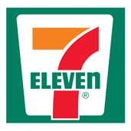
FORTUNE 1000
Notes:
So no matter the nature of your business, you’re in good company.
There are 38 Fortune 1000 companies headquartered in DFW.
All of the world’s top global cities share three major factors:
Firstly, they serve as logistics centers, serving major markets around them and facilitating import/export trade.
Secondly, they are future-looking, welcoming and encouraging new innovation to make business easier.
And thirdly, they are great places for advanced services to thrive, allowing access to hundreds of companies, who all share a need for accountants, lawyers, IT professionals, insurance providers, and real estate services.
These factors contribute to the success of companies across all industries. As mentioned, the diversity of the corporate base in DFW is a major strength and stabilizing factor for the regional economy.

Slide 25
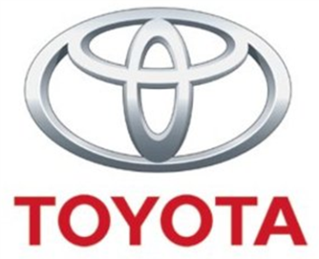
国際 企業
Notes:
This critical mass of Fortune 1000 companies allows us to attract other major companies from around the world. There are over 500 non-U.S. based companies with HQs, offices, or other operations in DFW.

Slide 26
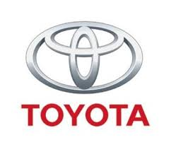
の成長は
日本企業によって促進されています
350社以上の日本企業が 米国本社および施設をかかる地域で運営しています
その数は、DFWに企業が存在する国のうち最多です
DFWの3番目に大きい
貿易パートナーであり、 取引額は$45.7億/¥4842.7億以上
（輸入および輸出）
Notes:
The newest Japanese company to announce a move to Dallas Fort Worth is Okidata, moving its Americas headquarters from New Jersey.
We are excited and proud to see the growth of Japanese companies in Dallas Fort Worth, we hope it leads to even greater trade and relations in the future.

Slide 27
経済の強み
国内総生産（USD)
ロシア
スペイン
メキシコ
オランダ
サウジアラビア
アルゼンチン
スウェーデン
ポーランド
ベルギー
オーストリア
UAE
南アフリカ
シンガポール
DFWは、以下の分野でテキサス最大の地域です
テキサス
$1.64兆
31%
30%
ハイテク産業の雇用
製造業の雇用
DFW
$5770億
（州GDPの36%）
DFWは、次の分野で 国内ナンバーワンです
資本投資と 雇用創出
MSA 1人あたりのGDP
家屋新築
Notes:
These inbound companies all contribute to the overall strength of our regional economy.
DFW’s $577B economy represents $3 of every $10 produced by the State of Texas.
DFW’s economy is larger than the economy of many countries, including Belgium, the United Arab Emirates, and Singapore. At the state level, Texas’ GDP is larger than that of some countries, including Russia and Mexico.
It’s surprising to some, but DFW is the top metro in Texas for both high tech and manufacturing jobs, outweighing Austin and Houston. Outside of the state of Texas, DFW is the #1 metropolitan area for capital investment and job creation, per capita GDP, and new home construction.

Slide 28
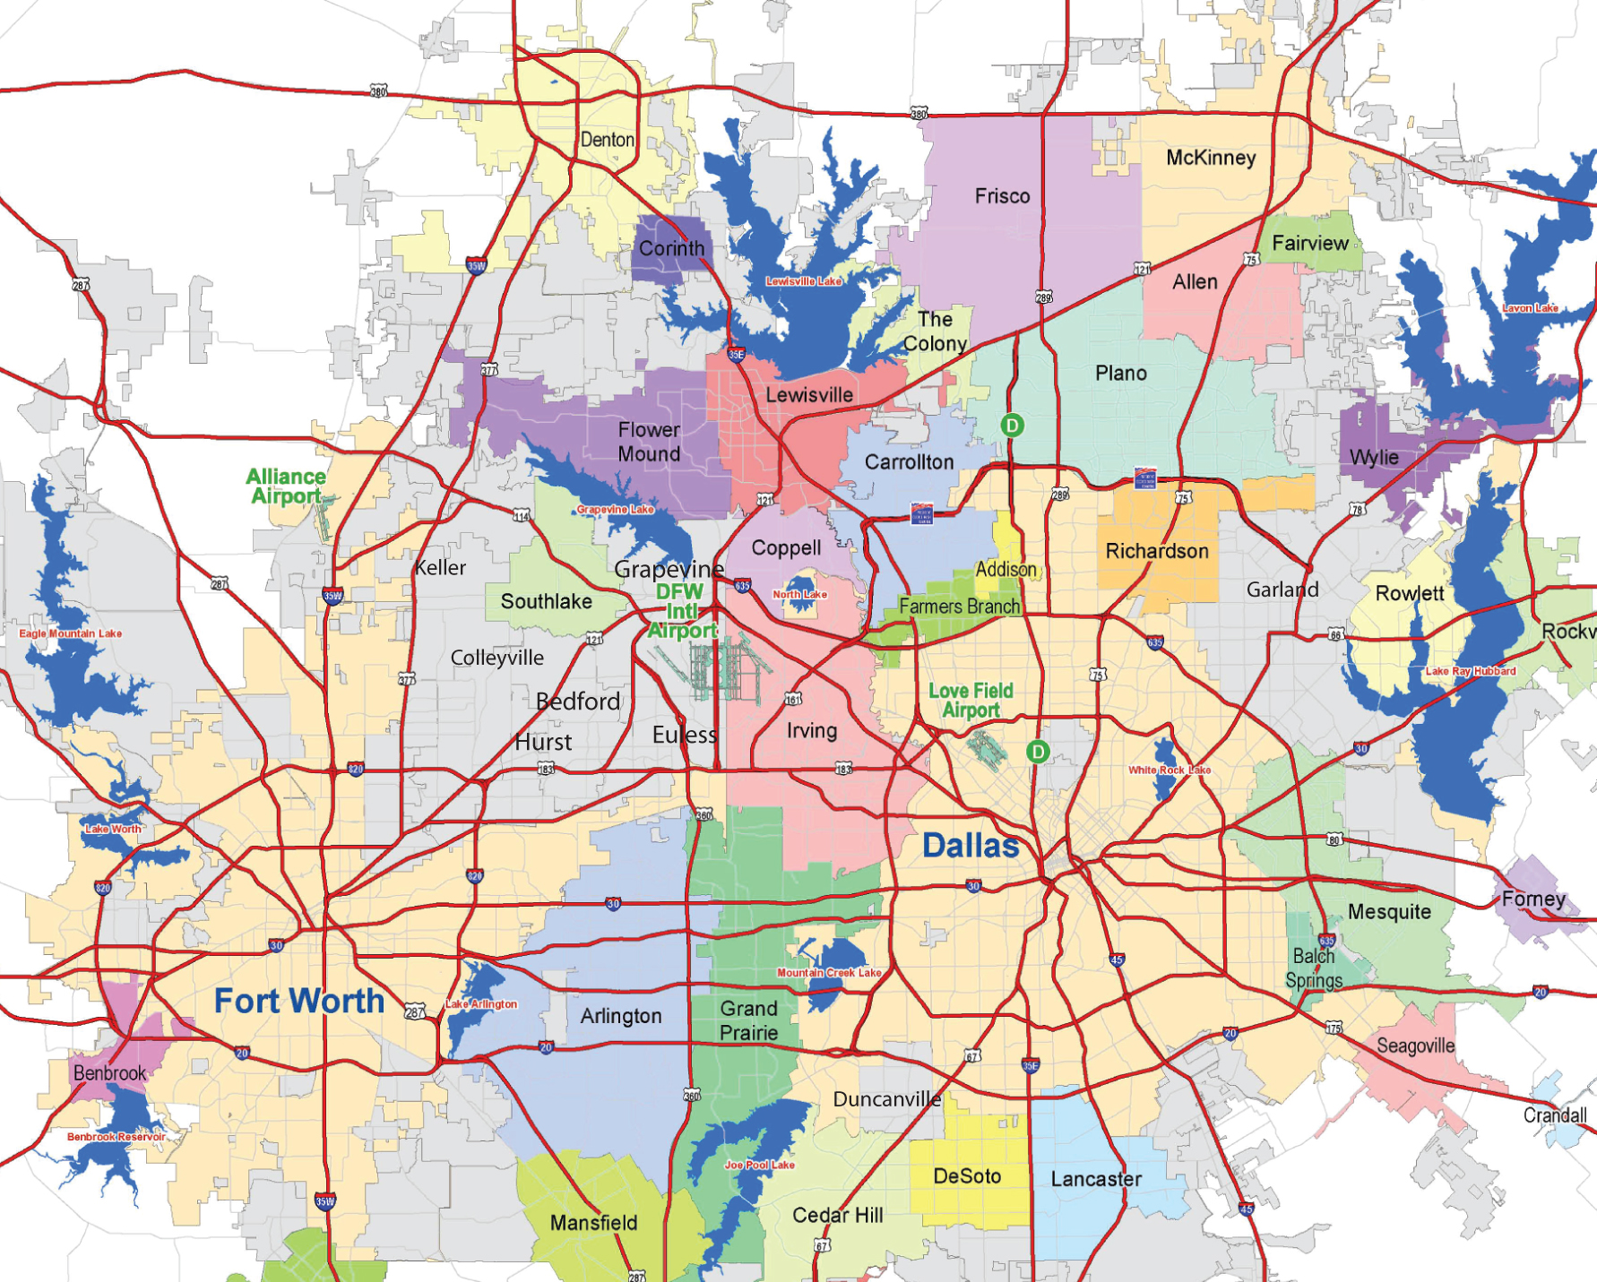
ダラス・
フォートワース
DFWが州であれば
GDPで9位
8位ニュージャージー | 10位ノースカロライナ
DFWが国であれば
GDPで23位
22位スウェーデン | 24位ナイジェリア
規模で4位
米国内の主要都市地域
Notes:
With a heavy presence of major national and multinational companies in our region, it’s no surprise we have a regional economy that is competitive with other states and even with other countries.
To compare our regional economy by GDP on the domestic scale, if this region were its own state, its economy would be in the Top 10 and would closely rival those of New Jersey and North Carolina.
Comparing globally, if DFW were its own country, we would be right up there in the Top 25, just after Sweden.

Slide 29
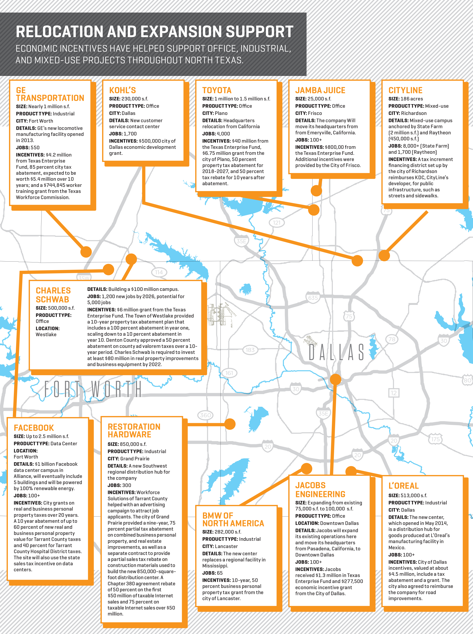
ビジネスインセンティブ
地方インセンティブ
フリーポート免税
経済開発法（第313章）
TIF地区
減税
第380/381章協定
タイプAおよびBの経済開発企業
州のインセンティブ
テキサス企業ファンド
製造業免税措置
天然ガスと電気
データセンター・インセンティブ
研究開発
技術開発ファンド
州知事による大学研究助成制度（GURI）
テキサス製品開発および小規模事業インキュベーターファンド
（PDSBI）
連邦政府インセンティブ
海外貿易ゾーン

Slide 30
グローバル 貿易センター
DFWと 日本の貿易： ¥4567.2億
30
DFWからの上位輸出品 （USD）
47.5%
航空機および部品 $73億
半導体 $29億
通信装置 $27億
自動車 $23億
¥2398.9億
DFWから日本への輸出
DFWからの上位輸出サービス （USD）
52.5%
¥2168.3億
金融 $22億
航空輸送 $17億
貨物運送 $17億
管理 $13億
IT $12億
日本からDFWへの輸入
日本との貿易はDFWの国際取引総額の6.04%です
Notes:
The total value of the DFW-world import/export relationship in 2016 was $69.36B, with about 67% of that total being imports and about 33% being exports.
To add some context: China is by far DFW’s largest trading partner, with a total annual trade averaging $24B, of which 94% is imports. Our strength as an importing region is due largely to our central location and our consequent ability to serve as a springboard for goods being shipping to the rest of the country.
We also do our fair share of exporting. Many goods and services are produced in and exported from DFW, especially aerospace and aviation parts, high tech goods, and advanced services.

Slide 31
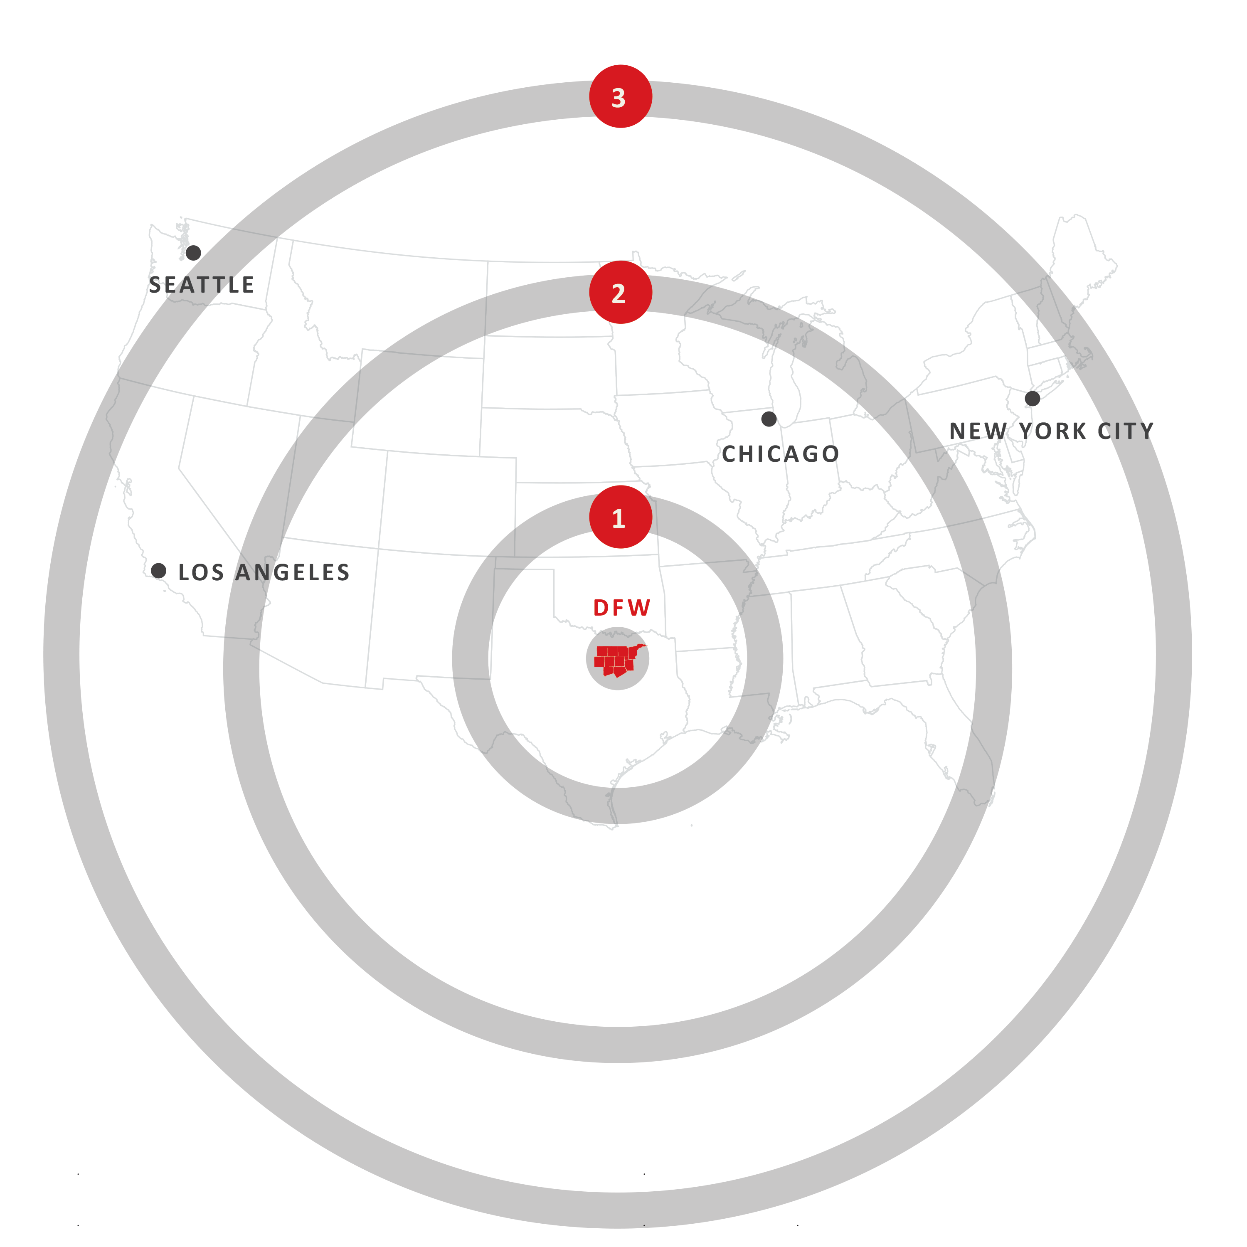
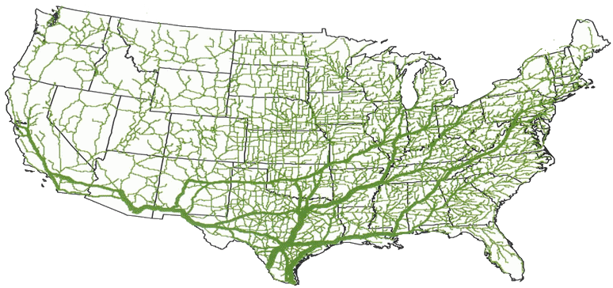
国内アクセス
範囲
時間
キロメートル
対象人口（%）
1
10
966
16%
2
24
1,545
37%
3
48
2,887
93%
Notes:
Additionally, because of its location in the U.S. and the regional convergence of airway, highway, and railway, DFW is one of the country’s greatest centers for logistics. You can see, on the bottom left, that DFW is a major artery for U.S. highways, making it a central hub for companies like UPS and FedEx. Many major retailers, such as Amazon, Walmart, and Wayfair have a large distribution presence in the region.
In just 48 hours, you can drive anywhere in the U.S. and anywhere in most of Canada and Mexico. DFW is equidistant from Toronto and Mexico City, making trade even more straightforward for companies with operations spanning North America.
DFW is also home to 4 foreign trade zones, several customs centers, and a wide range of freight services, making international trade that much easier.

Slide 32
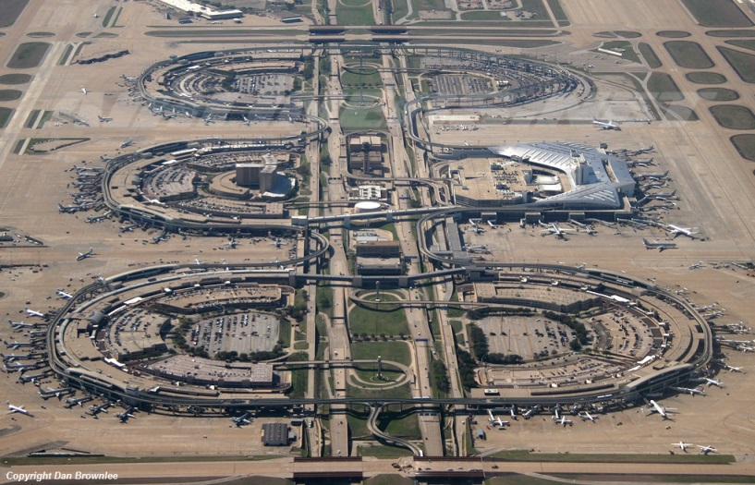
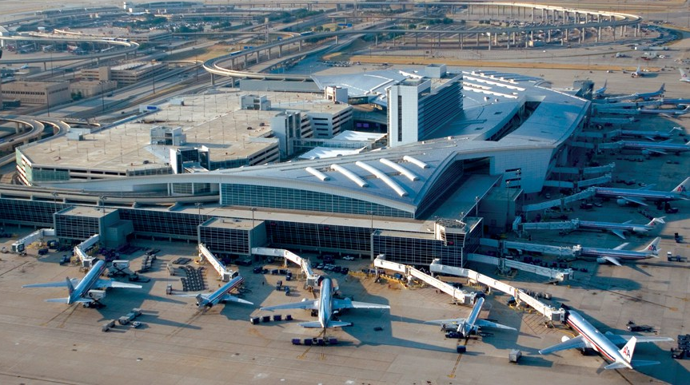
世界の主要都市への
直行便
210
の直行便
数字で見るDFW国際空港
182
の国内目的地
毎日170,000以上の乗客数
165の搭乗口
24時間営業
7つの滑走路
62
5つのターミナル
の海外目的地
4機同時着陸
北米1のカーボンニュートラル空港
0スロット制限
グローバルアクセス
0時間の夜間閉鎖
Notes:
I want to take a moment to highlight the advantages of our central location.
Our air service – both for passengers and for cargo – is unparalleled in the United States.
Built in 1974 by the cities of Dallas and Fort Worth, DFW International Airport is an economic engine for the region, generating $16.6B in economic impact annually. DFW is one of the highest capacity airports in the world, and is continually rated among the best in customer service.
Anywhere your people and your products need to go, our two airports - DFW International Airport and Dallas Love Field - can get you there. In just 4 hours, you can fly anywhere in the continental United States.
This region is also home to the largest global airline – American Airlines – and the largest domestic airline – Southwest Airlines – making it simple to get anywhere here or abroad.

Slide 33
グローバルアクセス
毎日3便の直行便 ダラス・フォートワース国際空港（DFW） ---
東京成田国際空港（NRT）
毎日2便の直行便
毎日1便の直行便

Slide 34
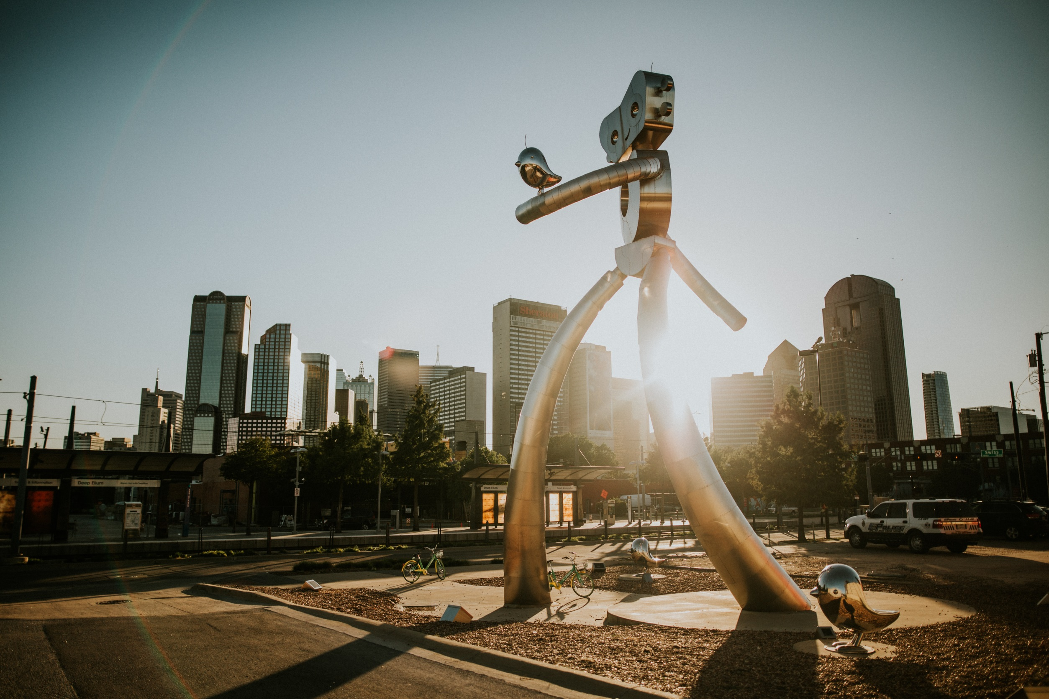
へようこそ
はダラス地域商工会議所の新しい タレントアトラクション キャンペーンで、この地域に新しく住むようになった方々へ食事、スポーツ、屋外エンターテイメント、買い物、芸術に関する情報を案内して、居心地よくお住まいいただくためのものです。
Sayyestodallas.com で、ダラス地域への移住に関する詳細がご覧いただけます！

Slide 35
へようこそ
は、ダラス地域商工会議所の イノベーション ガイドで、起業家と投資家の皆様に地域のイノベーション・エコシステムをもっとお知りいただき、利用していただくためのものです。
Dallasinnovates.com で、
ダラス地域のイノベーションに関する詳細をご覧いただけます！

Slide 36
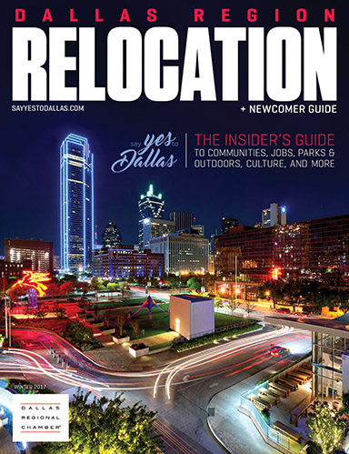
へようこそ
dallaschamberpublications.com で、次の出版物をすべてご覧いただ けます。
法律ガイド（RELOCATION GUIDE）– 新しい住人の皆さんが、地域の近隣、学校、ライフスタイルについて詳 しく知っていただけるものになっ ています。
不動産レビュー（REAL ESTATE REVIEW）– 住宅、商業、産業分野の完成済み、建設中、建設予定の不動産開発プロジェクトをご覧いただけます。

Slide 37
ダラス・フォートワース 日本企業 歓迎
Notes:
Thank you for having us – we’re happy to be here to answer any further questions you might have, to learn more about your business, and to work together to bring more international companies to the region. Thank you.

